Slide 1
Moral Conviction x Social Consensus Study 3 Initial GRAPHS?
Sean Duan

Slide 2
What Are We Trying to Say With Our Graphs?

Slide 3
Support for [Topic]
NO main effect of Social Consensus on support for [topic]
NO main effect of Moral Conviction on support for [topic]
Significant Pre-Post difference in support for [topic] across ALL conditions
Openness to Belief Change associated with support for [topic]
Initial Support predicts support for [topic]
Utilitarian orientation associated with increased support for “AI in the Workplace” only
Does the effect of the intervention change based on initial support?

Slide 4
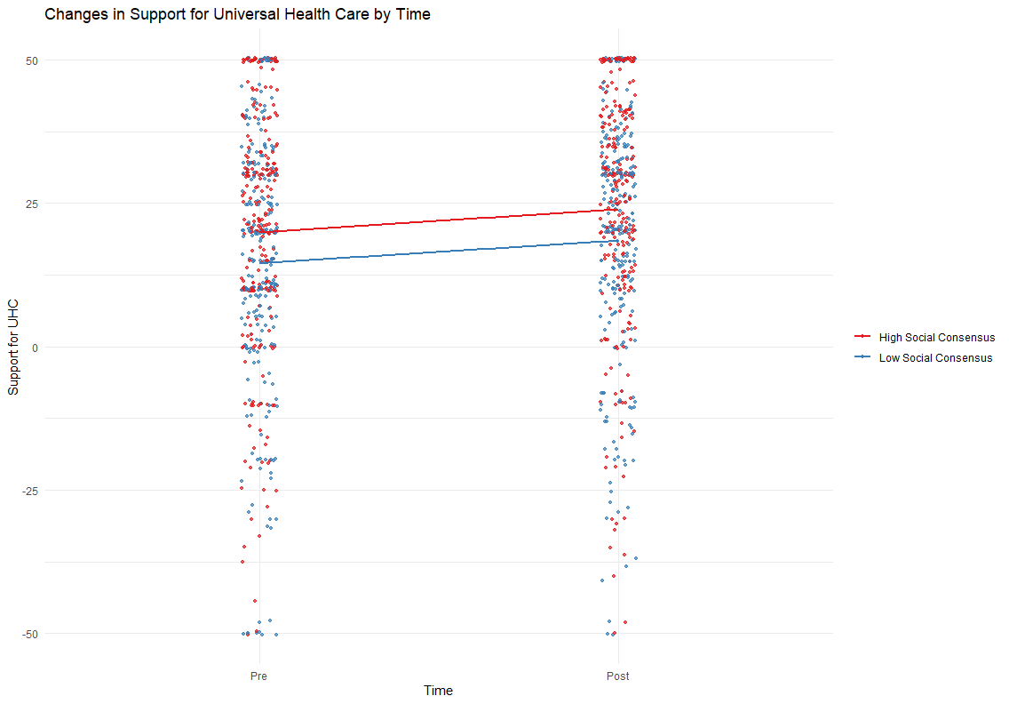
NO main effect of Social Consensus on support for [topic]

Slide 5
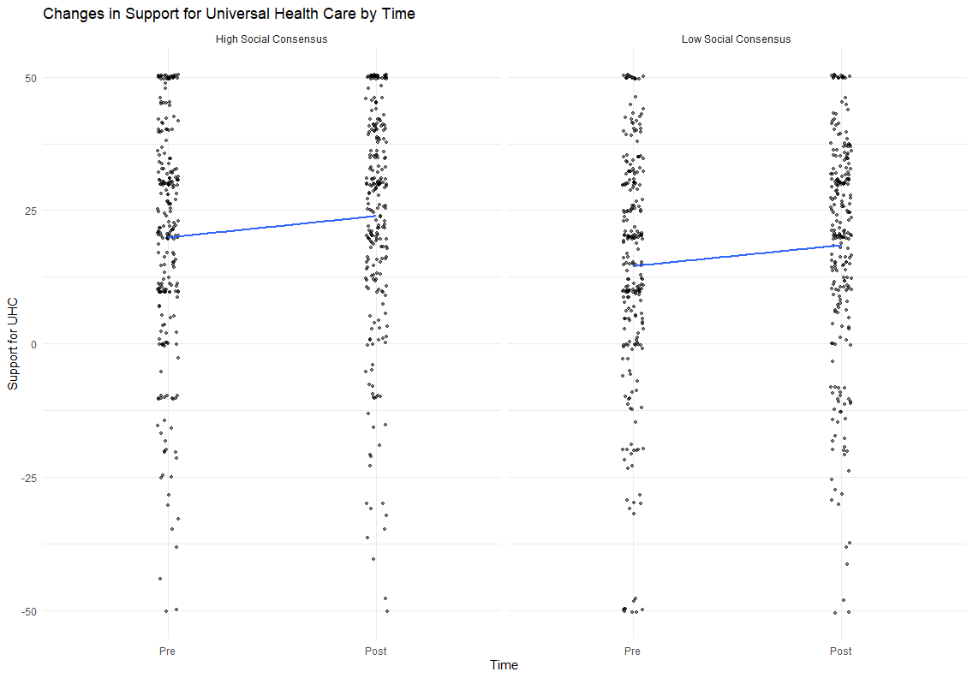
NO main effect of Social Consensus on support for [topic]

Slide 6
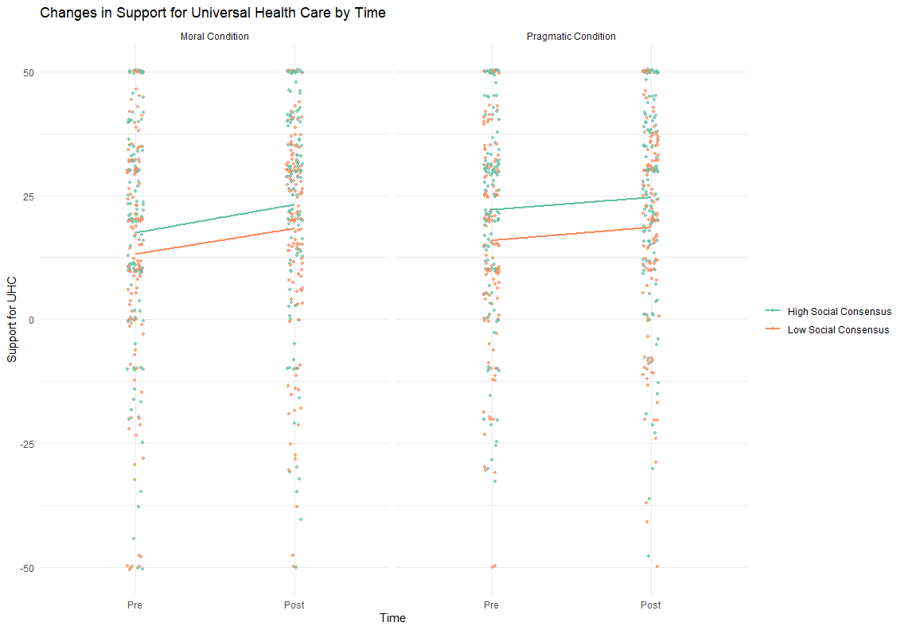
NO main effect of Social Consensus on support for [topic]

Slide 7
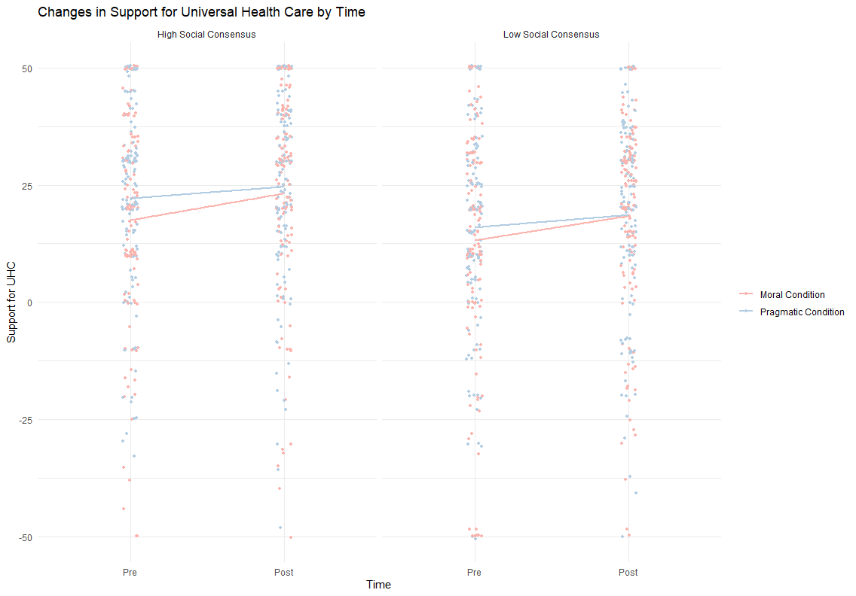
NO main effect of Social Consensus on support for [topic]

Slide 8
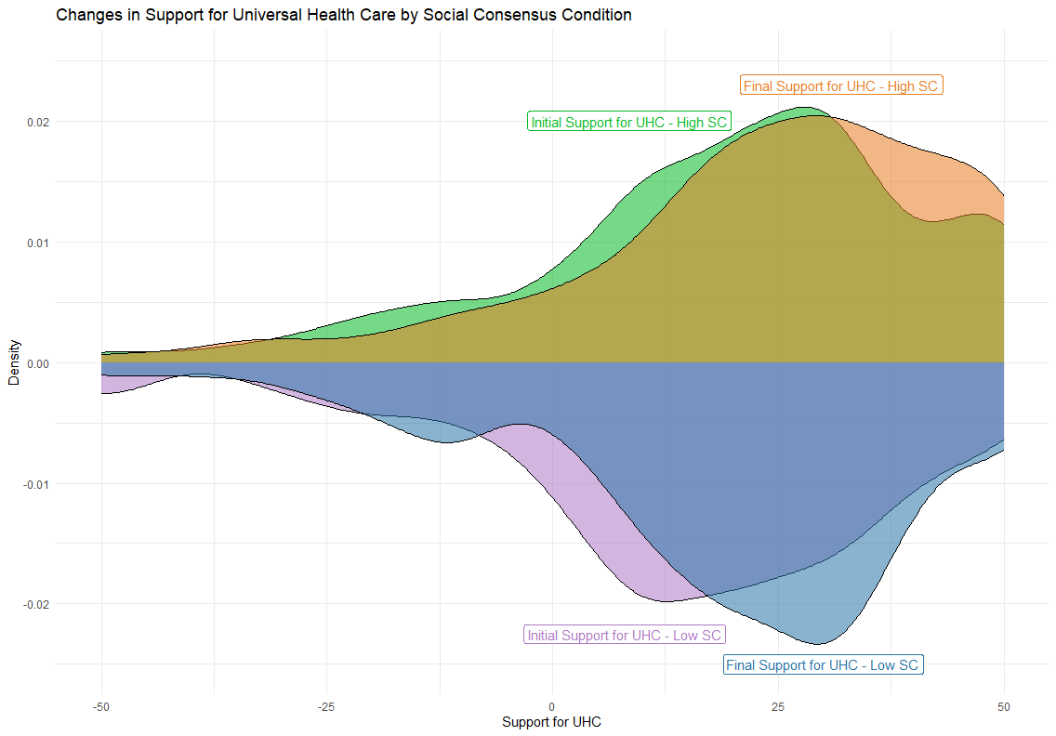
Significant Pre-Post difference in support for [topic]

Slide 9
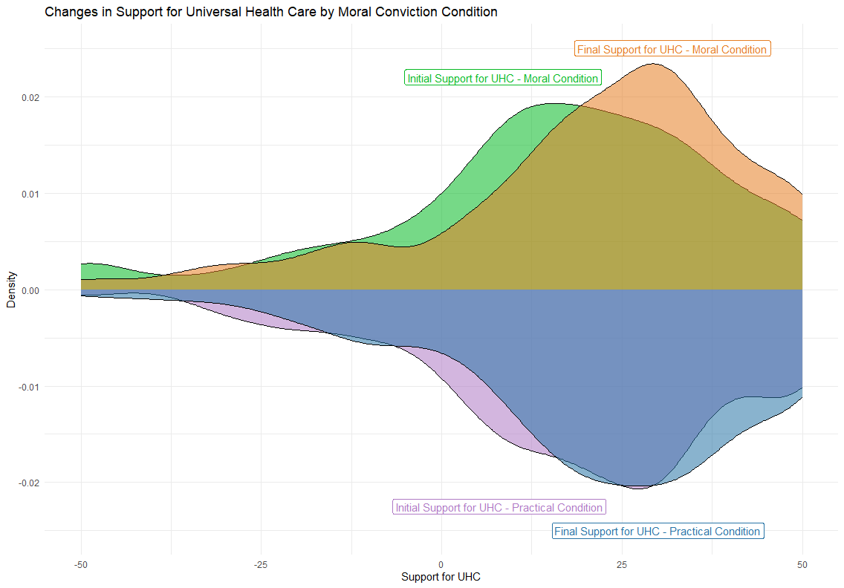
Significant Pre-Post difference in support for [topic]

Slide 10
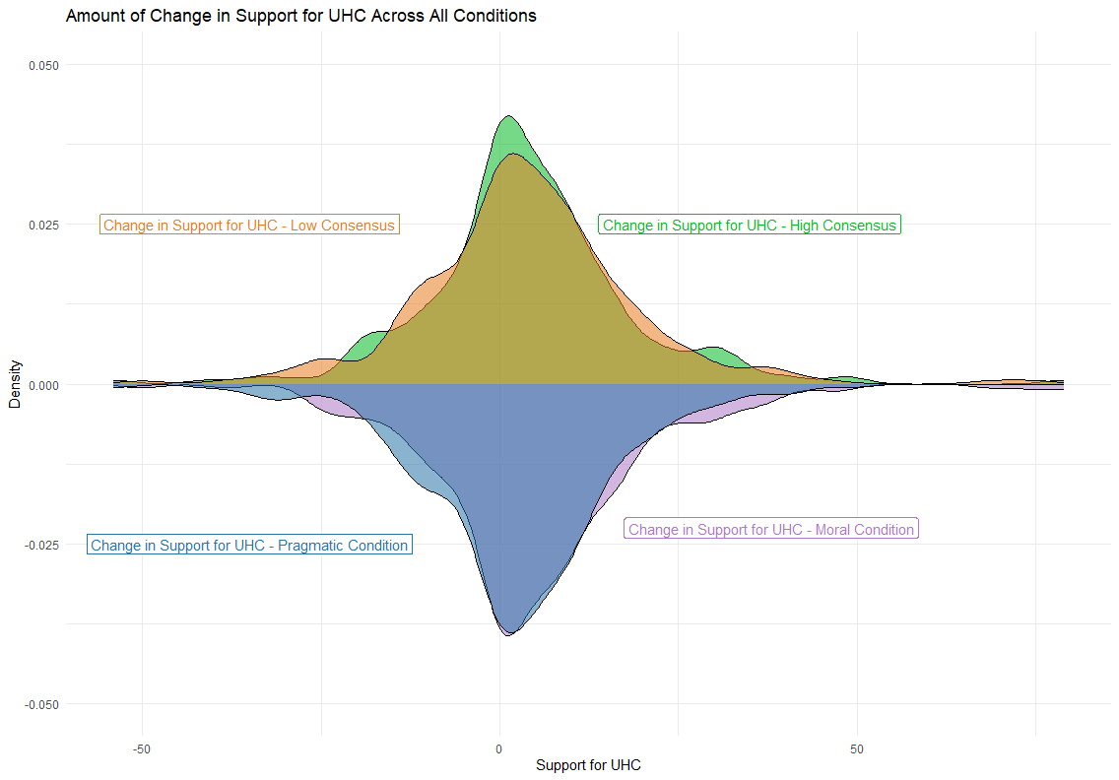
Significant Pre-Post difference in support for [topic]

Slide 11
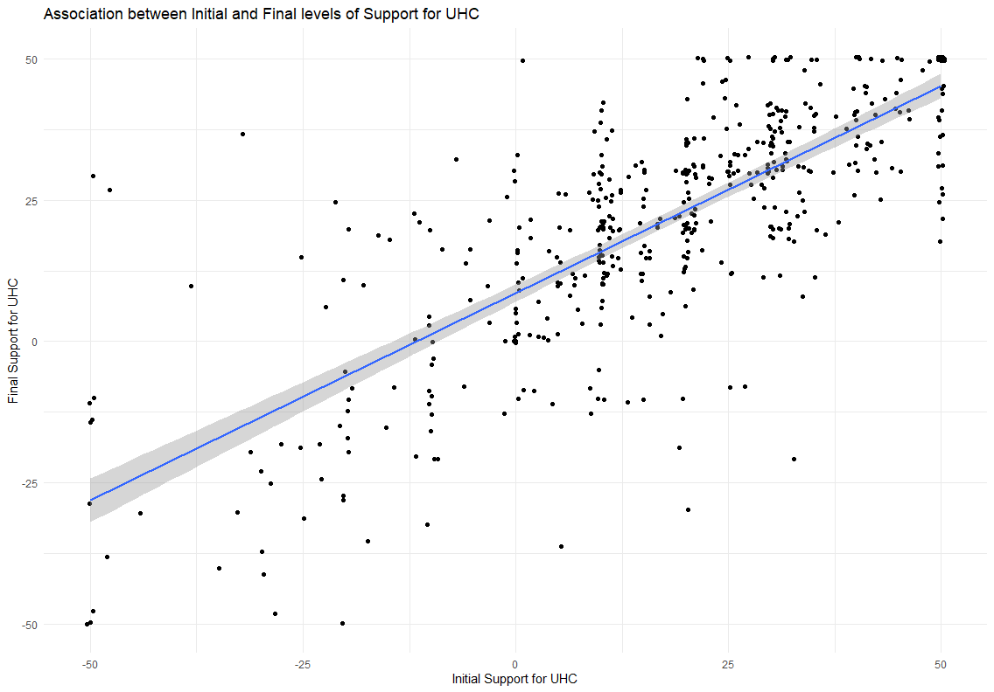
Initial Support predicts support for [topic]

Slide 12
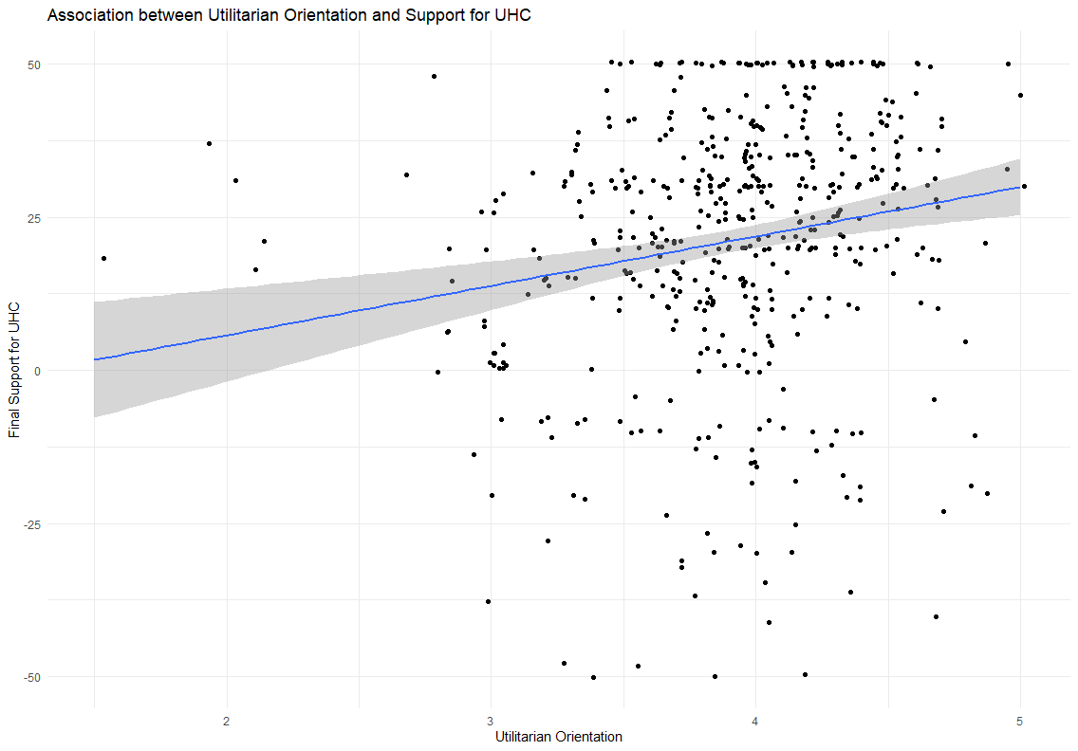
Utilitarian orientation associated with support for AI in the Workplace

Slide 13
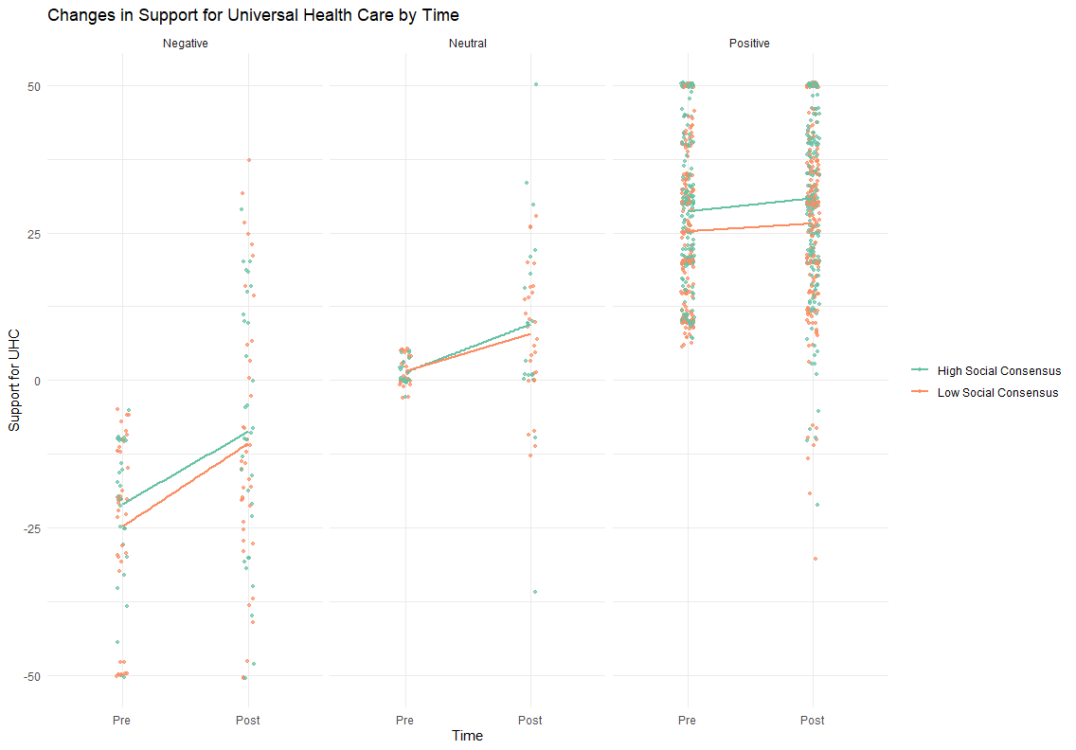
Does the effect of the intervention change based on initial support?

Slide 14
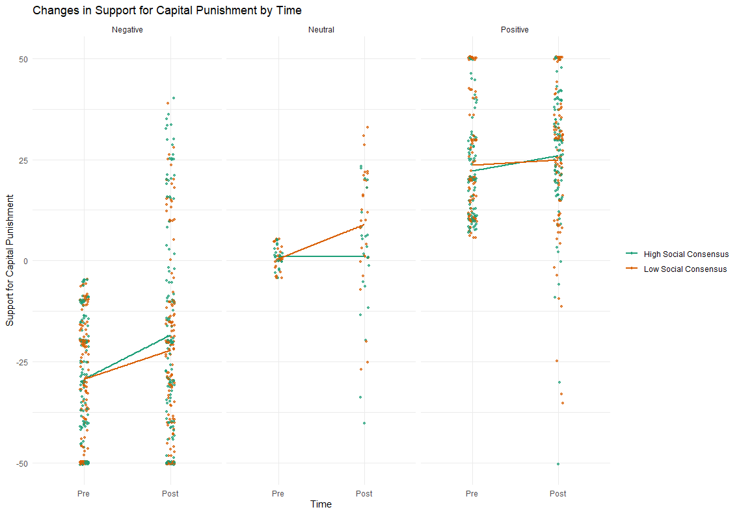
Does the effect of the intervention change based on initial support?

Slide 15
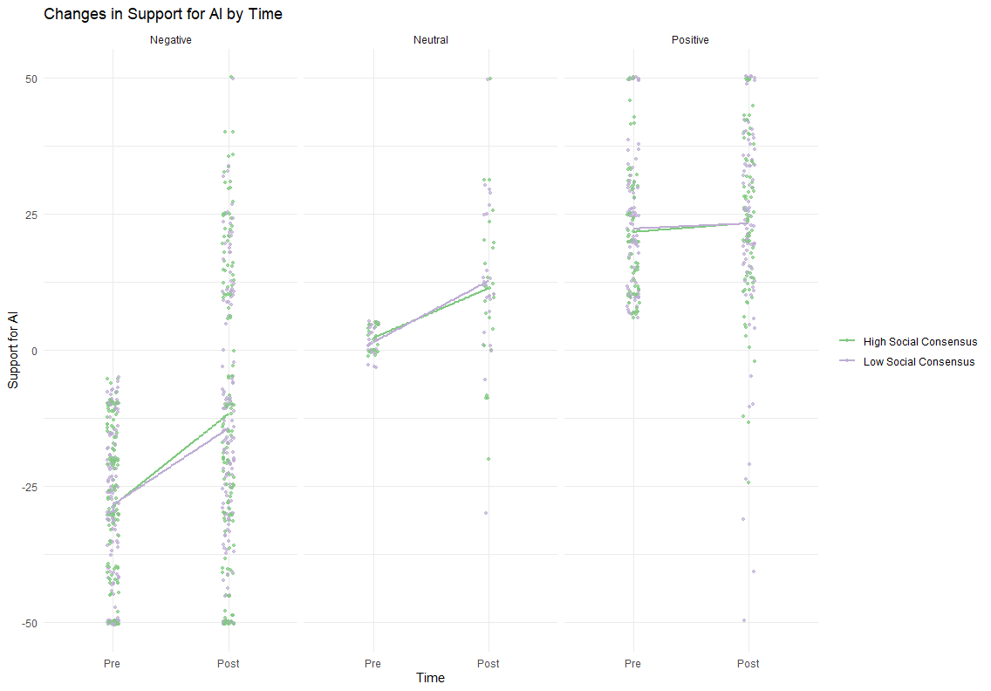
Does the effect of the intervention change based on initial support?

Slide 16
Moral Conviction for [Topic]
Moral Conviction Manipulation increased Moral Conviction for UHC
No effect on Capital Punishment or AI
Social Consensus Manipulation associated with increased Moral Conviction for AI
Greater Utilitarian Orientation associated with increased Moral Conviction
Greater Deontological Orientation associated with decreased Moral Conviction.

Slide 17
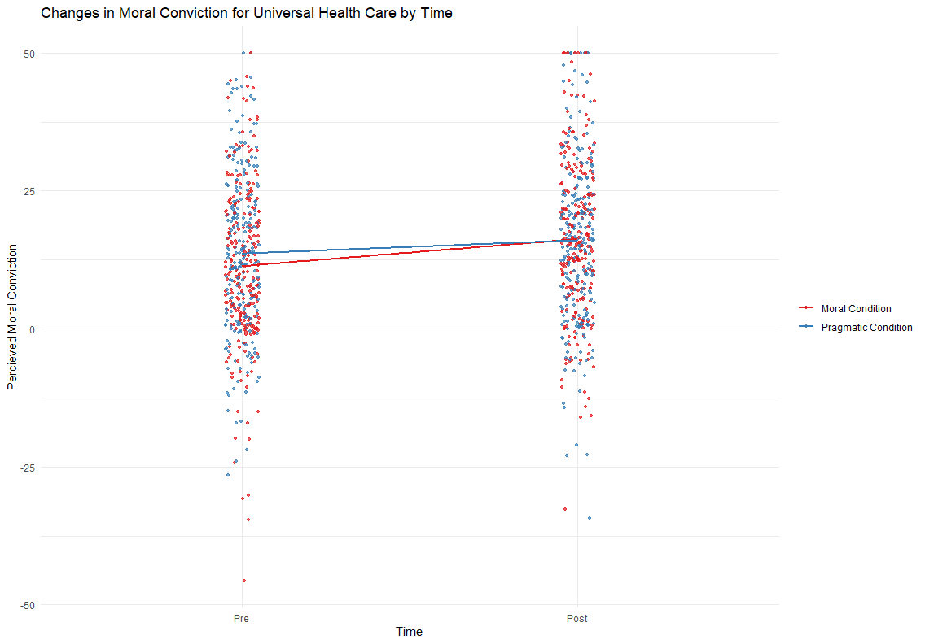
Moral Conviction Manipulation increased Moral Conviction for UHC

Slide 18
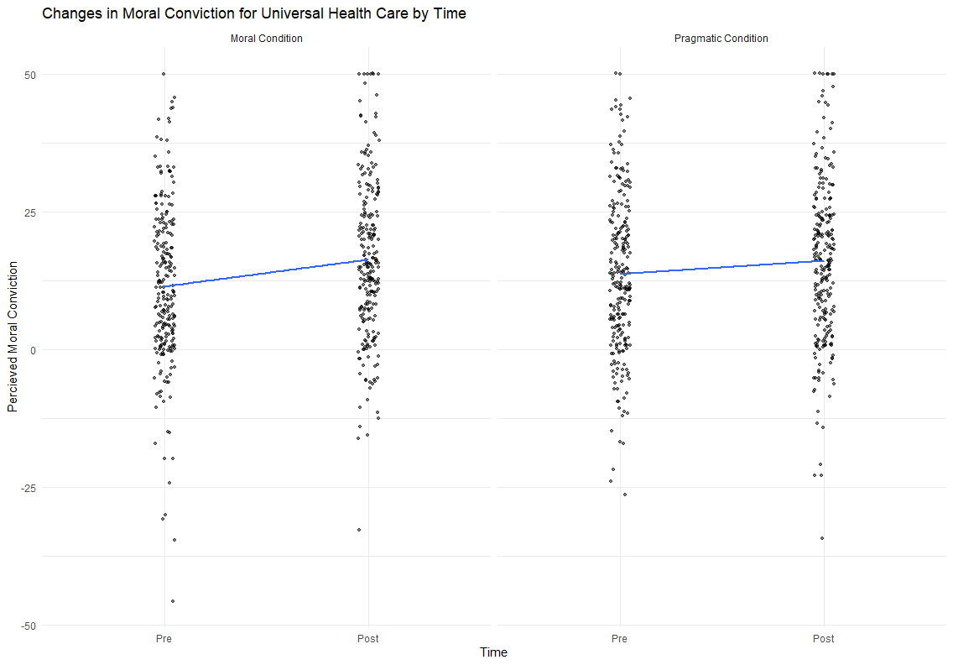
Moral Conviction Manipulation increased Moral Conviction for UHC

Slide 19
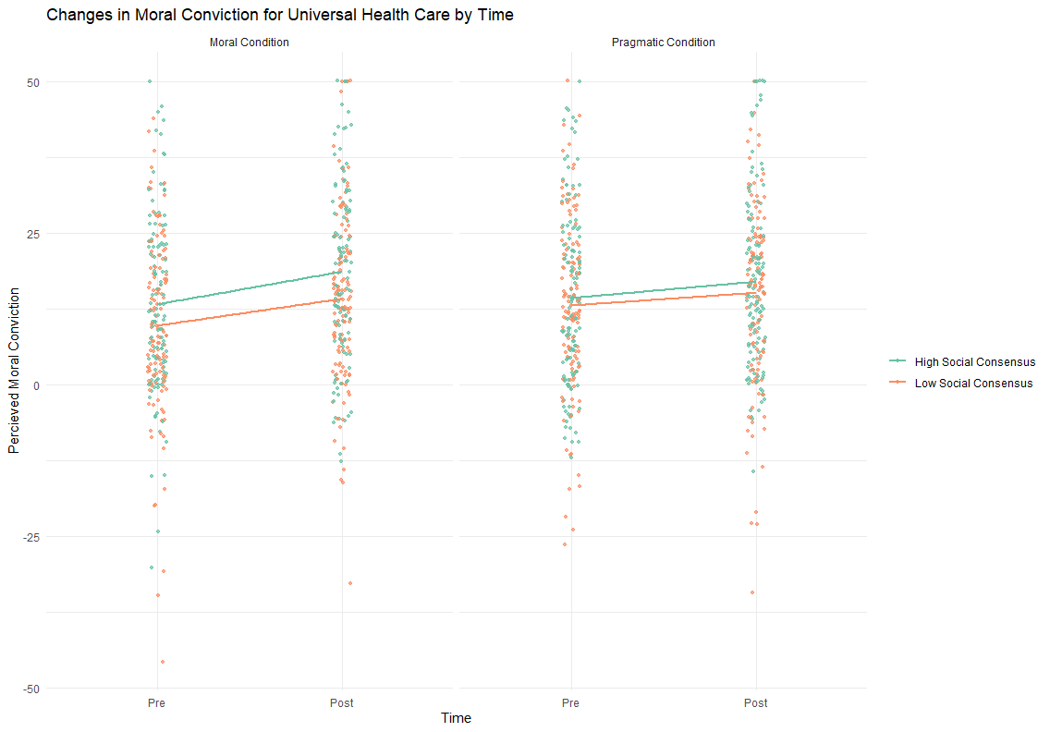
Moral Conviction Manipulation increased Moral Conviction for UHC

Slide 20
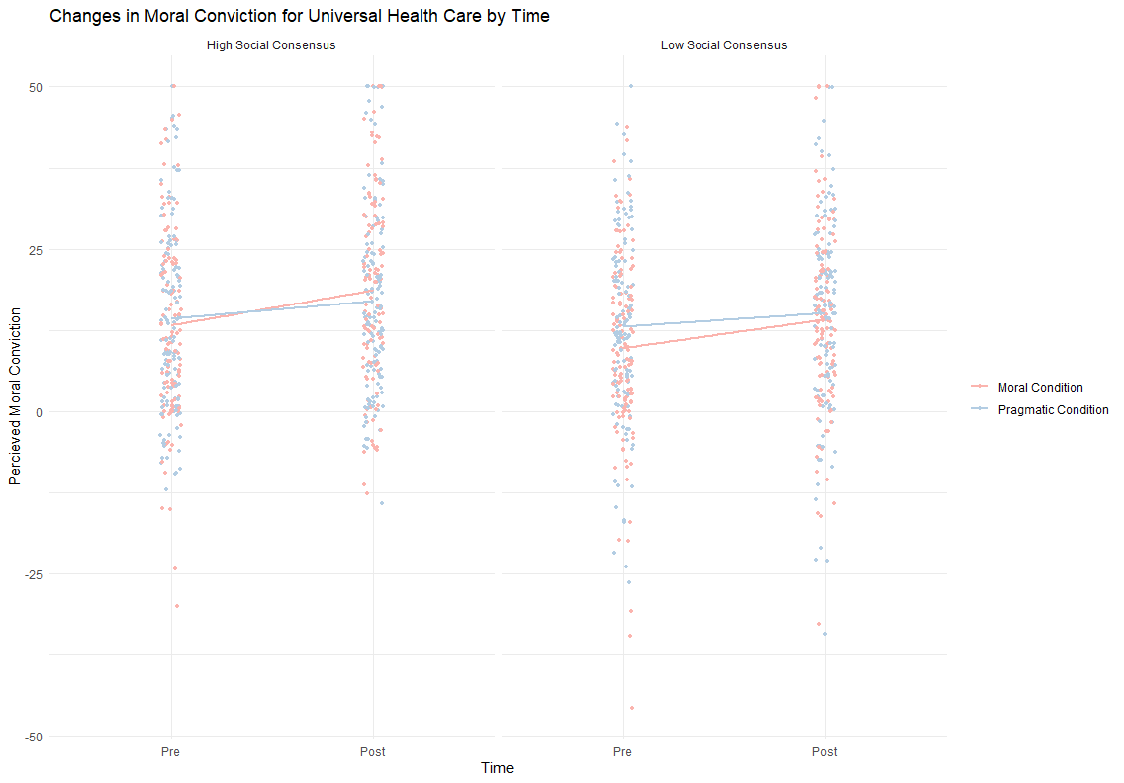
Moral Conviction Manipulation increased Moral Conviction for UHC

Slide 21
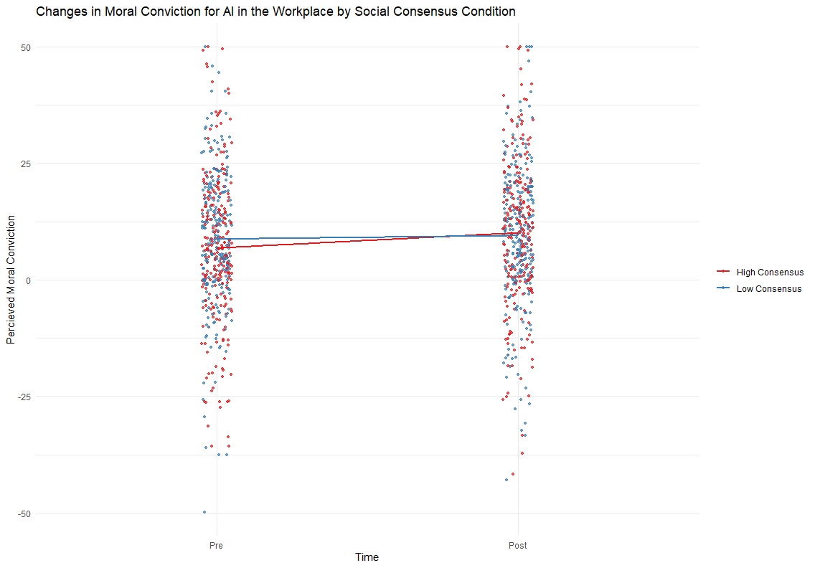
Social Consensus Manipulation associated with increased Moral Conviction for AI

Slide 22
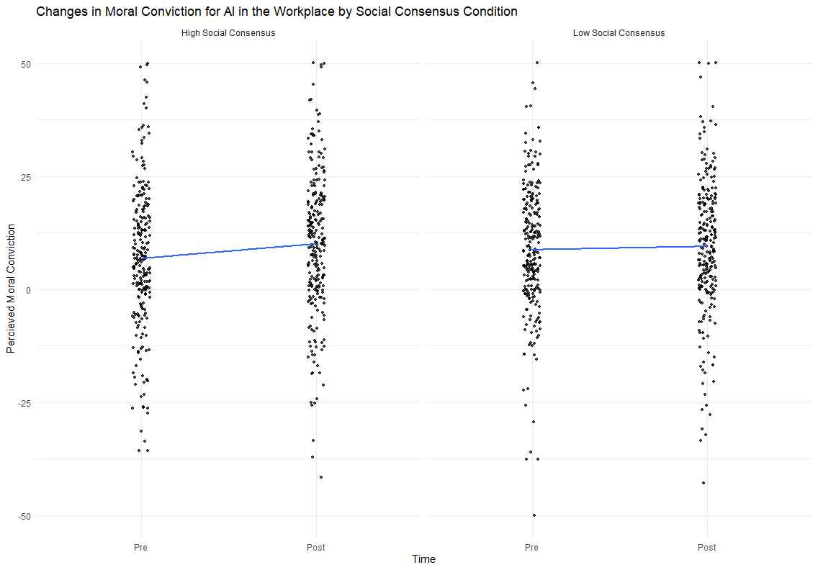
Social Consensus Manipulation associated with increased Moral Conviction for AI

